Slide 1
Disjoint set structures
Last time
  Splay Trees
Today
  Disjoint set structures

Slide 2
Disjoint set structures
Definition
  A collection of disjoint dynamic sets
  Each set is identified by a representative which is some member of the set
Three functions
  MakeSet(x) – create a new set whose only member is x
  FindSet(x) –find the set that contains x; return the representative
  Union(x, y) – unites the corresponding sets that contains x and y respectively and choose a representative for the combined set
Used to implement partition

Slide 3
Goal
Assumption
  Assume m operations, MakeSet, FindSet, and Union
  n of which are MakeSet operations
Goal:
  Find efficient structures and algorithms for all these operations

Slide 4
Linked List Representation
Represent each set as a link list
  The first object is the representative
  A pointer, head, pointing to the representative
  A pointer, tail, pointing to the last object of the list
    For easy union
  Each object has two pointers
    next: points to the next object in the list
    rep: points to the representative
a
b
c
d
^
head
tail

Slide 5
Union for Linked-list
Union(x, y) // add list x to the tail of y
{
cur = x.head;
while (cur != null) {
cur.rep = y;
cur = cur.next;
}
y.tail.next = x.head;
y.tail = x.tail;
}

Slide 6
What’s the problem
MakeSet and FindSet take constant time
For Union, we have to update the rep pointer of every node on one set.
  Worst case: Ө(n²)
    MakeSet(x₁)
    MakeSet(x₂)
    …
    MakeSet(x_{n})
    Union(x₁, x₂)
    Union(x₂, x₃)
    …
    Union(x_{n-1}, x_{n})

Slide 7
A weighted-union heuristic
Maintain the length for each list
Always join the shorter list to the longer list
Theorem: Using the linked-list representation of disjoint set and the weighted-union heuristic, a sequence of m operations, n of which are MakeSet, takes O(m+nlgn) time

Slide 8
Union for Linked-list
WeightedUnion(x, y)
{
if (x.length > y.length) {
Union(y, x);
x.length += y.length;
} else {
Union(x, y);
y.length += x.length
}
}

Slide 9
Disjoint-set forest
Represent each set as a rooted tree
  Each member points only to its parent
  The root is the representative
  The root’s parent is itself
1
2
3
4
8
9
5
6
7
10

Slide 10

Implementation: disjoint-set forest
FindSet(x)
{
r = x;
while (r.parent != r)
r = r.parent;
return r;
}
Union(x, y)
{
Link(FindSet(x), FindSet(y));
}
Θ(n) in worst case
Θ(n) in worst case
Link(x, y)
{
x.parent = y;
}
MakeSet(x)
{
x.parent = x;
}
Θ(1)
Θ(1)
Θ(n²) in worst case for m operations
when m Θ(n)

Slide 11
Improvements: two heuristics
Union by rank
  Rank: for each node, its rank is an upper bound on its height
  Union: the root with smaller rank is made pointed to the root with larger rank
Path compression
  Make each node on the find path directly point to the root
  find path: the path FindSet goes through

Slide 12
Union by rank
Link(x,y)
{
if (x.rank > y.rank) {
y.parent = x;
} else {
x.parent = y;
if (x.rank == y.rank)
y.rank++;
}
}
Θ(1)

Slide 13
Path compression
Squash the path when doing FindSet(), so the next FindSet() will be likely quicker (path compression).
  first pass to find the root
  second pass change the pointers along the path to the root and make them all point to the root
FindSet(x)
{
r = x;
while (r.parent <> r)
r = r.parent;
i = x;
while (i <> r) {
j = i.parent;
i.parent = r;
i = j;
}
return r;
}

Slide 14
An example
6
4
9
11
1
10
8
12
20
21
16

Slide 15
Efficiency with the two heuristics combined
A sequence of m operations, n of which are MakeSet, takes O(m α(n)) time
  Practically, α(n) <= 4

Slide 16
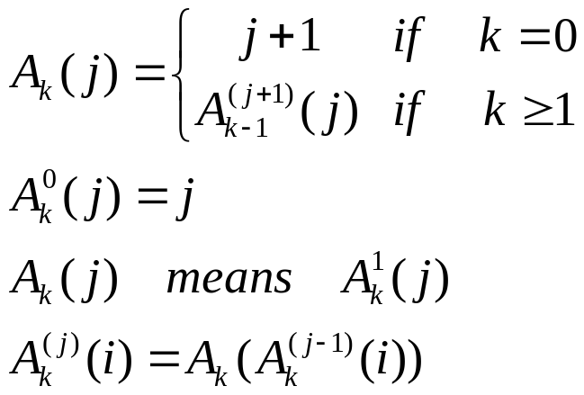
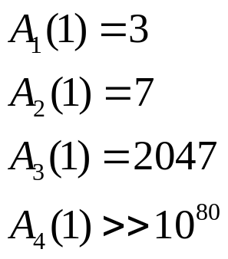
A quickly growing function

Slide 17
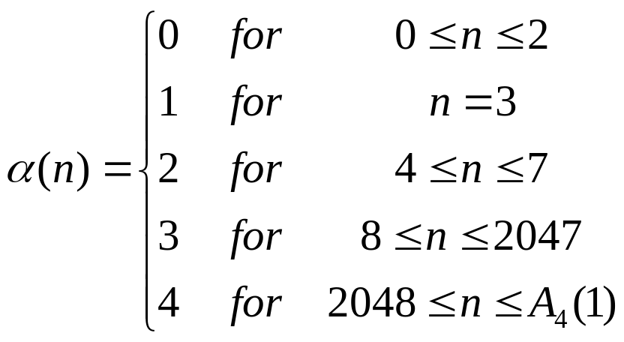
Definition of α(n)

